Slide 1


NYC Healthcare Navigator
Group 5: Ansuman Patnaik
Mridul Sankarakumar
Yashwant Sai

Slide 2
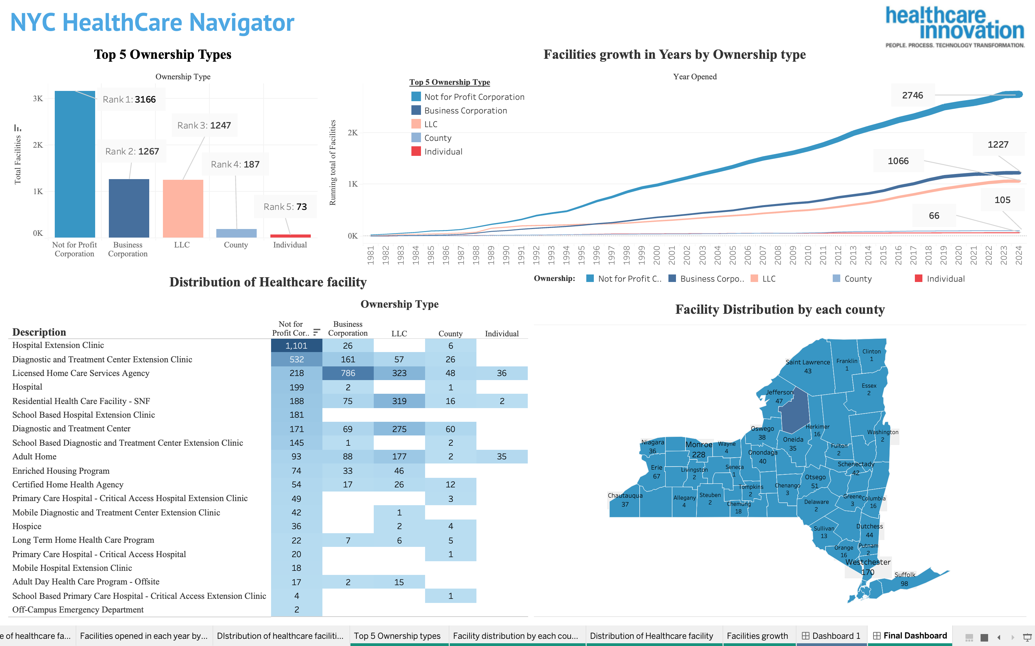

Slide 3

3-Minute story
Olivia Mitchell is the Chief Medical Officer at Healthcare Innovation, and she has a mission to make healthcare simple and accessible for everyone in New York State. She has a $1 billion budget to manage healthcare, but she faces a big challenge—the city's healthcare system is complicated. There are hospitals, clinics, and other facilities, all owned by different groups like not-for-profit corporations, business corporations, private companies, and individuals. This can make it really confusing for people who need to find the right healthcare quickly.
Olivia wanted a team of analysts to analyse healthcare data and help her find a solution called the NYC HealthCare Navigator. It's a dashboard that helps people find healthcare in New York State. The dashboard has a simple map showing where all the healthcare facilities are located. It also has a recommendation feature that helps users find the best places to go for their healthcare needs. People can see what services each facility offers, making it easier to choose the right one.
The NYC HealthCare Navigator isn't just for patients and families—it also helps healthcare professionals like Olivia and various policymakers as well. With this dashboard, Olivia can see where there are gaps in healthcare services and where she should focus her company's resources. It's a tool that makes the whole healthcare system easier to understand.
Now, Olivia can make better decisions. She can find the best places to open new facilities and ensure that everyone in New York City has access to the healthcare they need. The dashboard helps families find care for their loved ones, students find nearby clinics, and healthcare professionals understand where to focus their efforts.

Slide 4


